Slide 1
Indeed.com - Compatibility Test
By Brian Keuthan, Jenny Nguyen, Ruthlene Jeannelas

Slide 2
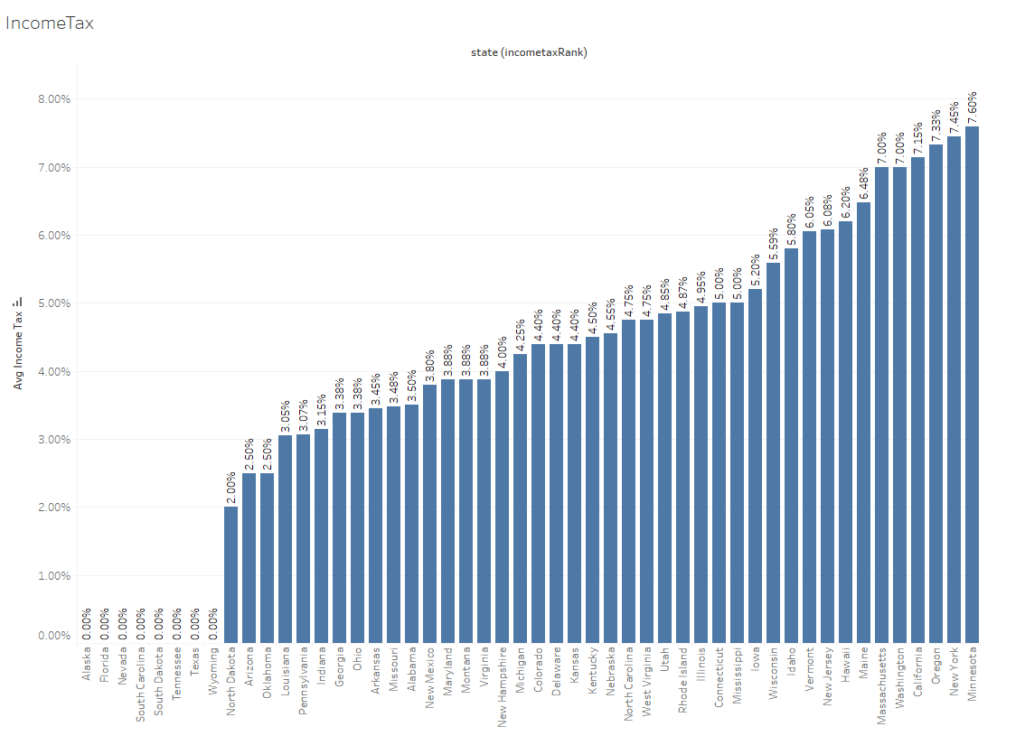
Cost of Living - Income Tax
States with No Income Tax Rate: Alaska, Florida, Nevada, S.Carolina, S.Dakota, Tennessee, Texas, Wyoming

Slide 3
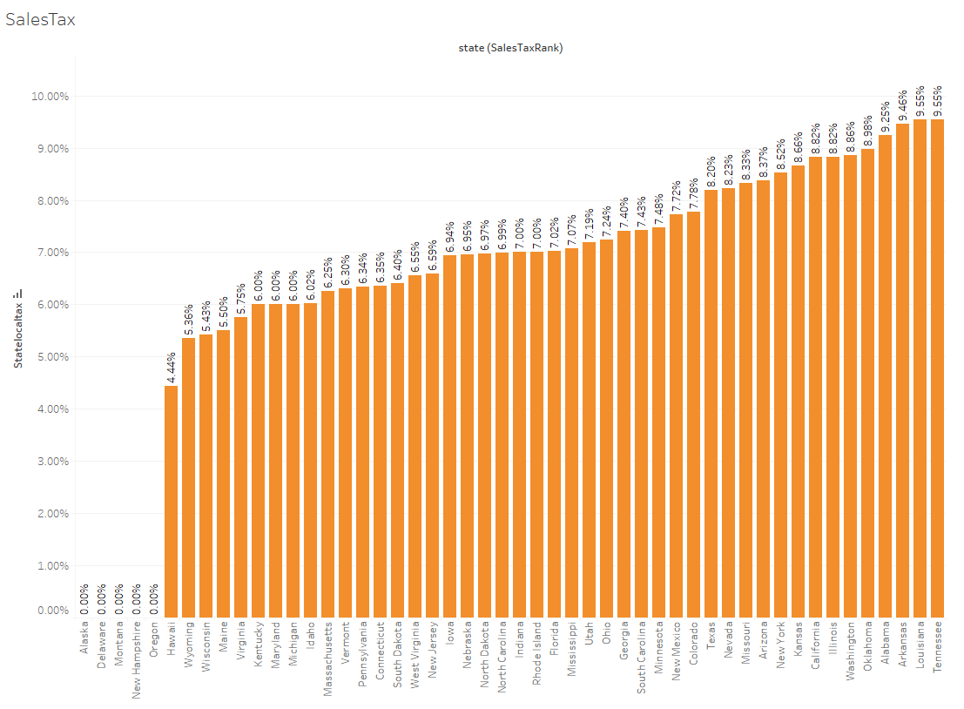
Cost of Living - Sales Tax
States with No Sales Tax Rate: Alaska, Delaware, Montana, New Hampshire, Oregon

Slide 4
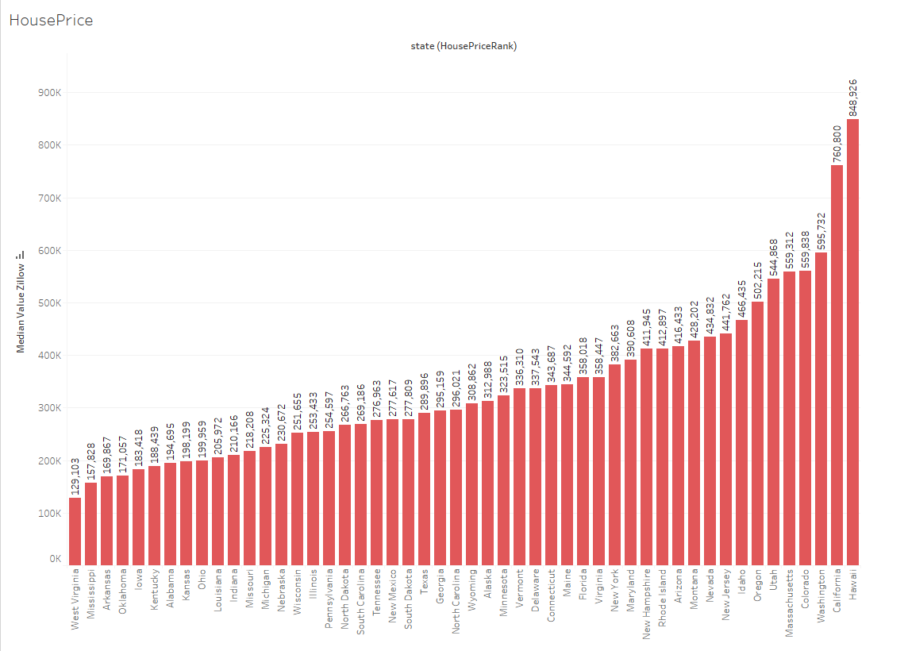
Cost of Living - Average House Price
Top 5 States with Lowest Average House Price based on Zillow 2023: W. Virginia, Mississippi, Arkansas, Oklahoma, Iowa

Slide 5
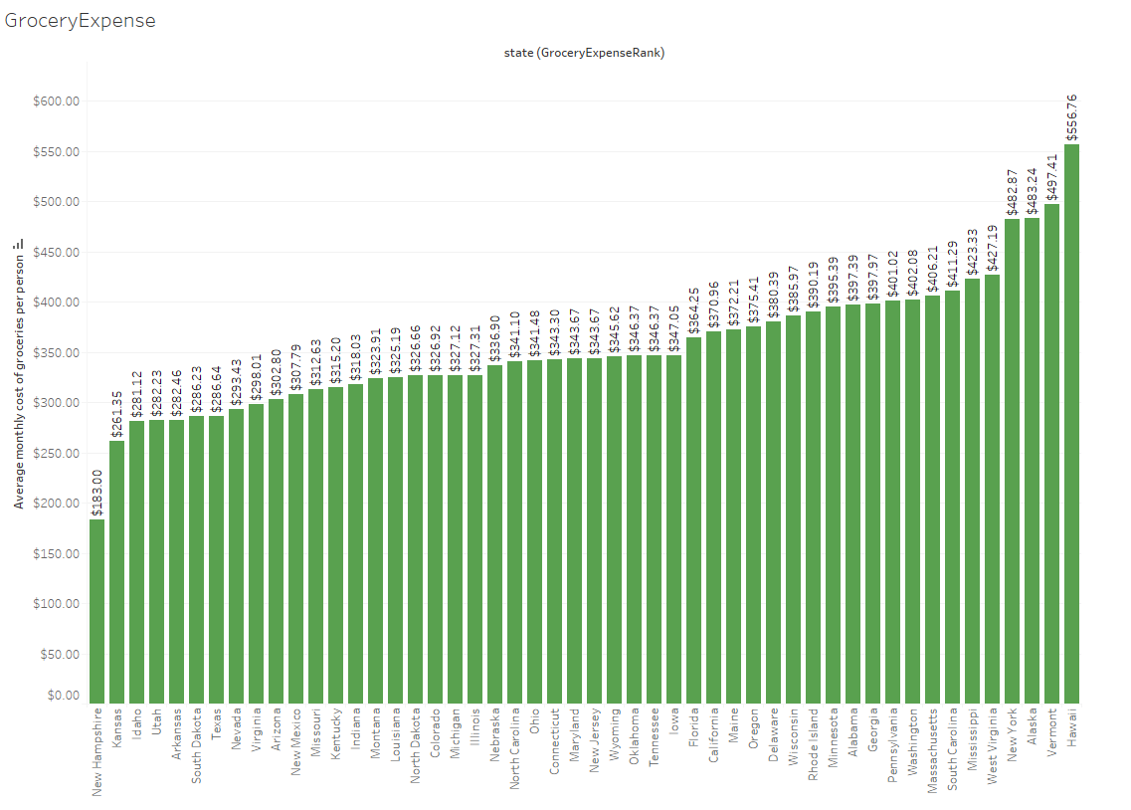
Cost of Living - Average Monthly Grocery Expense
Top 5 States with Lowest Average Monthly Grocery Expense: New Hampshire, Kansas, Idaho, Utah, Arkansas

Slide 6
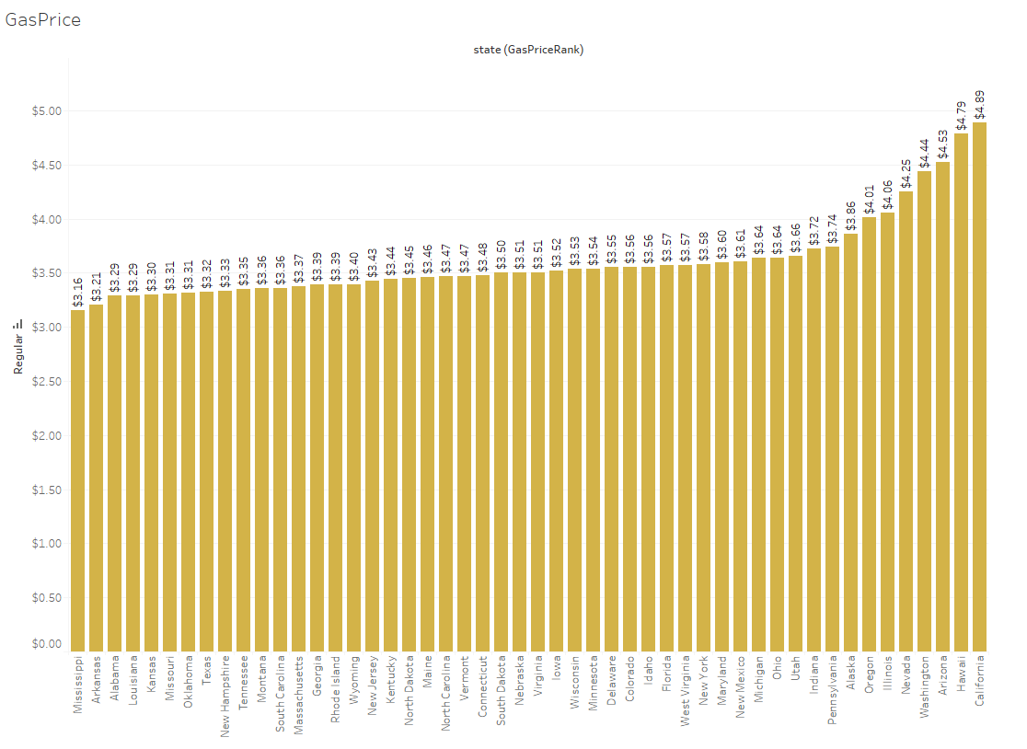
Cost of Living - Average Gas Price
Top 5 States with Lowest Average Gas Price: Mississippi, Arkansas, Alabama, Louisiana, Kansas

Slide 7
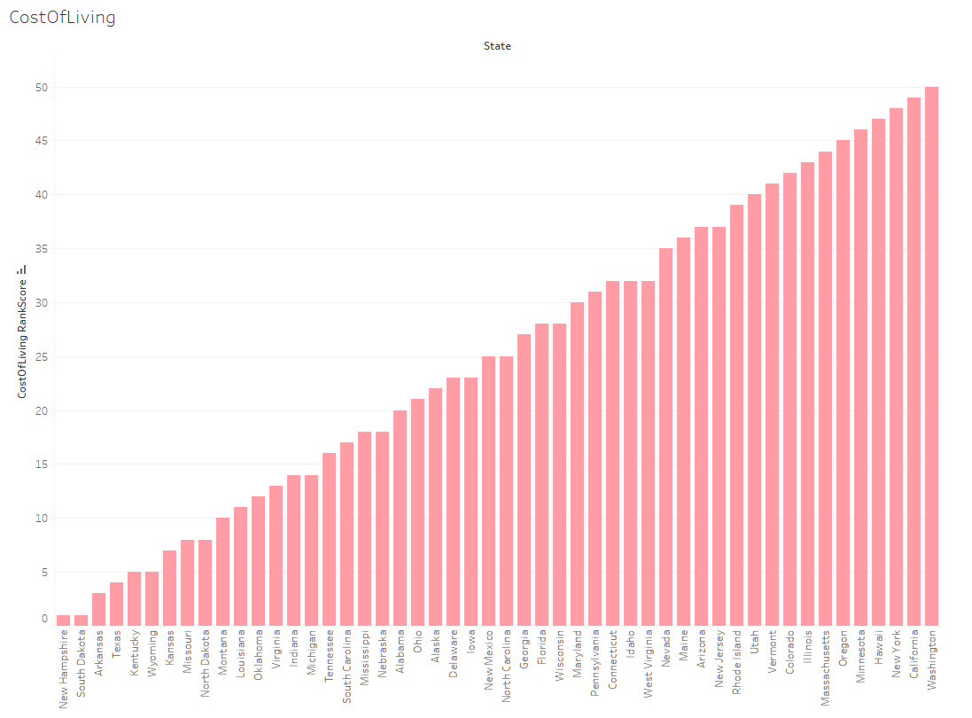
Cost of Living - Summary - Ranking
Based on 5 mentioned factors for Cost of Living, top 5 states with lowest expenses:
New Hampshire, S.Dakota, Arkansas, Texas, Kentucky

Slide 8
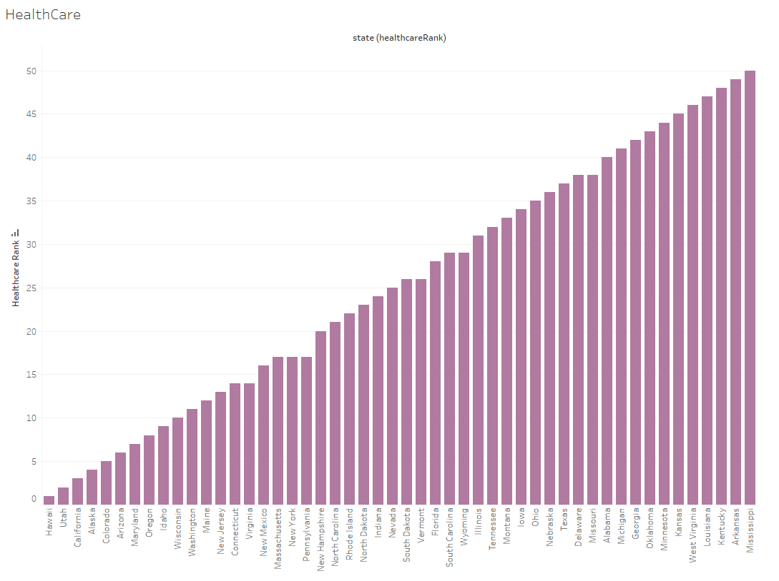
Health Care Quality - Ranking
Top 5 States with Best Health Care Quality Ranking: Hawaii, Utah, California, Alaska, Colorado.
Based On: Hospital Quality, Medicare Quality, Nursing Home Quality, Preventative Admissions.

Slide 9
What other factors can affect your decision?
Politics
Transportation
Culture
Weather
Career opportunities
Infrastructure
Exploratory areas to consider that can impact the decision for job seekers to relocate.
Notes:
As job seekers consider making a change and moving to new state, a variety of factors can determine where to make to best move. We emphasized that compatibility of the most important factors when choosing a place to live have different levels of importance to job seekers. In our project we’ve focused on the top factors that can impact these decisions such as Income, Education, Crime, Cost of Living, and Quality of Life as well as Location.
We also have acknowledged other exploratory factors to consider that can also make an impact on the decision for job seekers to relocate:
Politics - Transportation - Culture - Weather - Career opportunities - Infrastructure
Special emphasis on politics and culture of a community, can help influence the decision for job seekers to relocate. The level of diversity with respect to race, religion, sexuality, socioeconomic issues and ethnic culture can all relate to the community’s culture.
Having the available career and job opportunities that not only meet the financial needs, support, and fulfillment in the work that would be done. The importance of using job search sites, such as indeed, linkedIn, glassdoor, etc. contribute in showing the employment opportunities that are available to job seekers in the state that they are considering moving to.
When considering a big city or suburban area will be different for everyone. Public transportation and infrastructure can also be a major obstacle in relocation. In different areas may or may not require the need for a personal vehicle to get around with the availability of streamlined public transportation. But is something to consider for the greatest level of convenience and efficiency.

Slide 10
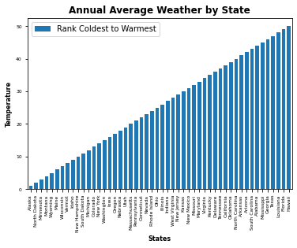
Weather
Notes:
CONTINUED. . . . .
As job seekers looking for the BEST possible place to live in proximity to some of the best real estate and quality of life, climate has a huge impact on decision making and an important factor to explore.
The data collected from typical weather patterns in the past 5 years (2018-2022) has shown an the average temperature for each state. When considering these climate conditions, job seekers would want to keep in mind of weather preferences along with the common factors mentioned in this project, when comparing each state.

Slide 11
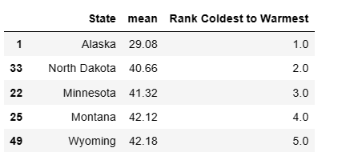
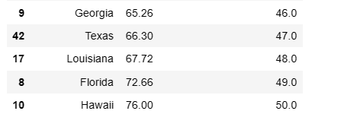
Average Temperatures:
Top Coldest States vs Top Warmest States
(2018 - 2022)
Notes:
Even the data used has shown a difference in average per state to get an idea of the typical weather patterns and make sure that job seekers are okay with the climate conditions before deciding to move. The probability of weather would have an influence decision making for job seekers.
For example: Top 5 coldest states (Alaska, North Dakota, Minnesota, Montana, Wyoming)
vs Top 5 warmest states (Hawaii, Florida, Louisiana, Texas, Georgia)
Using resources with considerable amount of data can help job seekers make a decision on jobs and where they want to relocate.

Slide 12
References
Weather: https://www.ncei.noaa.gov/access/monitoring/climate-at-a-glance/statewide/time-series
Cost of Living:
https://gasprices.aaa.com/state-gas-price-averages/
https://www.zippia.com/advice/average-cost-of-groceries-by-state/
https://worldpopulationreview.com/state-rankings/tax-rates-by-state
https://worldpopulationreview.com/state-rankings/sales-tax-by-state
Healthcare Quality: https://www.usnews.com/news/best-states/rankings/health-care/healthcare-quality
Income: https://worldpopulationreview.com/state-rankings/median-household-income-by-state
Quality of Life: https://scholaroo.com/report/best-states-to-live-in/
Education: https://scholaroo.com/report/state-education-rankings/
Capital Coordinates: https://github.com/jasperdebie/VisInfo/blob/master/us-state-capitals.csv

